Slide 1
Francois Venter Technical Presentation Improving the development life-cycle
Notes:
Generalized Programming
Workflow Tools
Automation

Slide 2

Background!
OOP
Makes sense because data is structured.
Classes work perfectly as blueprints
<number>
Notes:
Data is usually structured, thus classes make perfect sense
In school we were taught how to mass produce these objects via classes
Take it a step further ?

Slide 3
1.Generalized Programming
<number>

Slide 4
Use the concept of classes on much bigger scales than just objects
<number>
Notes:
University taught us to design datastructures to suit our needs
But we can go even further beyond...

Slide 5
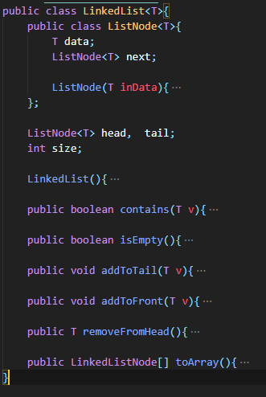
<number>
Notes:
University taught us to design datastructures to suit our needs
But we can go even further beyond...

Slide 6
Use the concept of classes on much bigger scales than just objects
<number>
Notes:
Making DataStructures, Services, Interfaces generic and reusable

Slide 7
Some Benefits
Creating simple multi use Components
Components are easily adaptable
Re usability improves greatly
<number>
Notes:
Create generic components, extensible, adaptable

Slide 8
Generalized programming
Angular Schematics
Java Packages
Namespaces in C-Languages
Modules in Ruby and JavaScript
<number>

Slide 9
This modularity is supported by a plethora of languages and frameworks
<number>
Notes:
Making DataStructures, Services, Interfaces generic and reusable

Slide 10
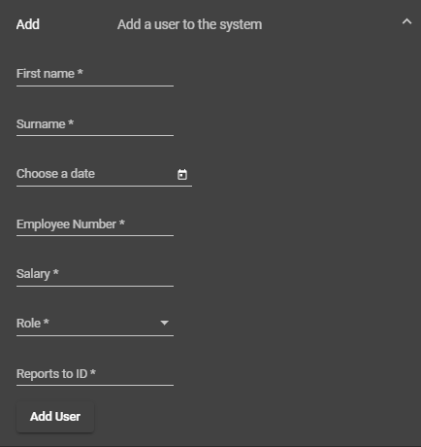
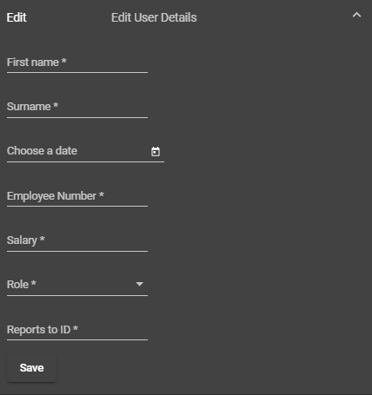
Simple example of generalized components
<number>
Notes:
Used in recent technical assesment

Slide 11
Issues with Specialized Programming
Compatibility
Most native languages compile for specific devices/architectures.
Prerequisites
Installing the correct packages per system becomes a problem
<number>

Slide 12
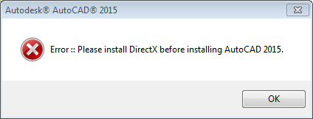
This Picture is worth a thousand words
Do you want the users to see this ?
<number>

Slide 13
How do we approach this problem
Prepackaged Programs, custom Libraries ?
Updates and changes
<number>
Notes:
Prebuilt Binaries (Exe’s, DMGs)

Slide 14
Issues
Prepackaged Programs -> bigger
Custom Libraries -> Dev Limitations
<number>
Notes:
Binaries are not secure or easily spoofed

Slide 15
Better solutions
Web Based
Frameworks like Angular, NodeJS, etc.
Mobile
Flutter
<number>
Notes:
Cross platform

Slide 16
Better solutions
Application Based
Frameworks like Electron, Qt, etc
<number>
Notes:
Also cross platform, includes requirements.

Slide 17
2. Workflow Tools
<number>

Slide 18
Basic tools
Git
CI/CD in git
<number>
Notes:
CI makes development for multiple people easy, CD is under utilized can do so much more than just compile the project

Slide 19
Why we use these
Rebuilding takes long
Classic languages on big projects can take long times to compile
Small Solution
Converting Modules to precompiled packages
<number>

Slide 20
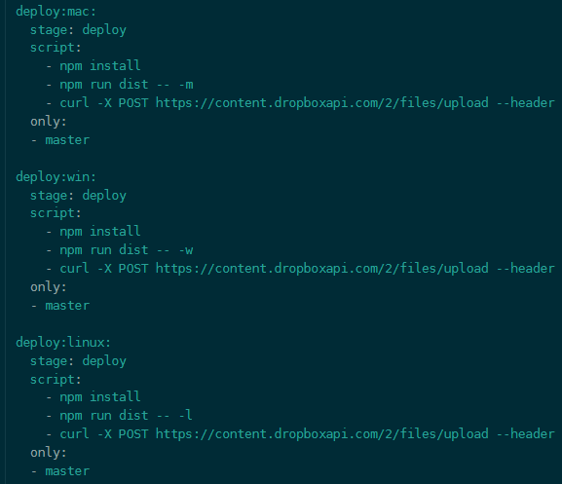
<number>
Notes:
Push patches to download servers

Slide 21
Better Solutions
Some frameworks have better solutions like Angular, NodeJS Ruby on Rails, Flutter, etc.
Only the changed code is recompiled.
Flutter has stateful hot reload
Ruby can Stay running ...
<number>
Notes:
Only compile changed code, flutter remembers what you had typed in, ruby isolates the module that has to be reinterpreted

Slide 22
Why Automation
Some tasks take up to much time
Tedious tasks like uploading documents
Flutter has stateful hot reload
Ruby can Stay running ...
<number>
Notes:
Only compile changed code, flutter remembers what you had typed in, ruby isolates the module that has to be reinterpreted

Slide 23
3. Automation
<number>

Slide 24
Some tasks just waste to much time, repetative, tedious tasks.
<number>
Notes:
Clientwork 900+ pdfs that had to be uploaded ...

Slide 25
Programs
Tapermonkey
Write basic scripts to automate small things in browser
Selenium
More comprehensive with more complex automations
<number>
Notes:
Tapermonkey for small scripts that can take small task in your browser off your hand
Selenium is a stronger platform with more in depth

Slide 26
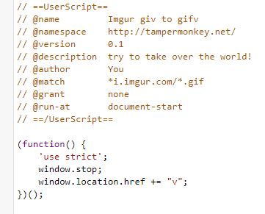
Basic Tapermonkey Script
<number>
Notes:
Basic script to save bandwidth

Slide 27
Puppeteer, the step up from both
<number>
Notes:
Puppeteer is a full fledged browser replacer when it comes to automation, can run headless, take screenshots, type and more

Slide 28
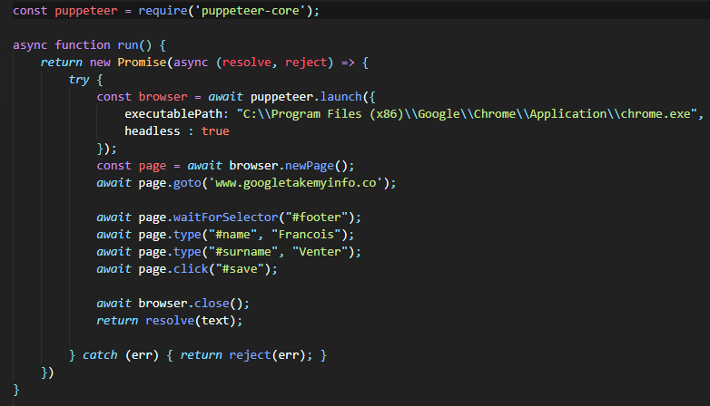
Small puppeteer example
<number>
Notes:
Basic example that fills in my details and saves

Slide 29
THANKS!
<number>

